Slide 1


Financial Data Analysis
Power BI

Slide 2

Agenda
  Project Overview
  Data Source
  Data Preparation
  Dashboard Visualizations
  Applications & Recommendations
  Conclusion
  Any Queries

Slide 3
Project Overview
  Developed a Power BI dashboard to analyze multi-year financial data from Income Statement, Balance Sheet, and Cash Flow reports.
  Consolidated financial metrics such as Revenue, Net Income, Assets, Liabilities, and Cash Flow from multiple company datasets.
  Built a star schema model with Date and Stock tables for efficient relationships and accurate time-based analysis.
  Created DAX measures for key performance indicators — Gross Margin %, Operating Income, Free Cash Flow, and Debt-to-Equity Ratio.
  Designed 5 interactive dashboards covering overall performance, profitability, financial structure, liquidity, and comparative analysis.
  Enabled decision-makers to identify high-performing companies, analyze growth trends, and assess financial stability across industries.

Slide 4
Data Source
  Dataset Name: Financial Statement Dataset
  File Type: Excel file
  Number of Datasets: 6 individual files
  incomeStatementHistory_annually.csv
  incomeStatementHistory_quarterly.csv
  balanceSheetHistory_annually.csv
  balanceSheetHistory_quarterly.csv
  cashflowStatement_annually.csv
  cashflowStatement_quarterly.csv
  Total Records: ~10,000 financial records (combined)
  Total Columns: 20–30 per file (covering Revenue, Net Income, Assets, Liabilities, Cash Flow, etc.)

Slide 5
Data Preparation
  Loaded 6 CSV files Income Statement, Balance Sheet, and Cash Flow (both annual and quarterly)
  into Power BI.
  Removed nulls and duplicates, standardized date formats, and converted text fields into numeric data
  types.
  Merged annual and quarterly datasets, aligned columns by stock and endDate, and unified financial
  metrics.
  Created new calculated fields such as Gross Margin %, Free Cash Flow, and Debt-to-Equity Ratio
  using DAX.
  Built Date, Stock, and Stack tables to establish a clean Star Schema with one-to-many relationships.
  Verified measure accuracy across all dashboards and ensured consistency between annual and quar
  -terly results.

Slide 6
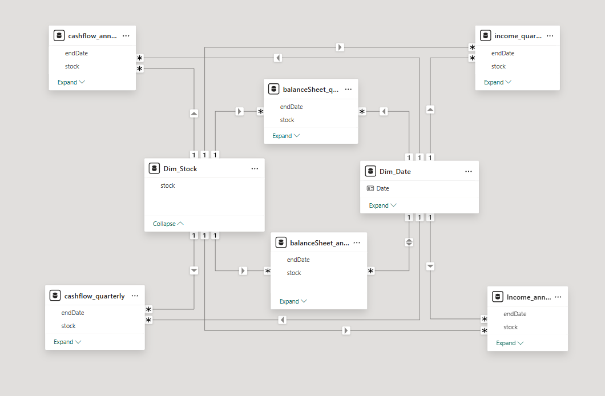
Data Model

Slide 7
Dashboard Visualizations
1. Financial Performance Dashboard
  Visuals Used:
  Bar Chart → Top Companies by Net Income
  Combo Chart → Total Assets vs Total Liabilities
  Line Chart → Cash & Equivalents Growth
  Line Chart → Retained Earnings Over Time
  Column Chart → Total Revenue by Company & Year
  Cards → Total Revenue, Net Income, Total Assets, Total Liabilities, Revenue Growth YoY
  Purpose: To provide an overall view of financial health, showing profitability, asset growth, and
  company-wise revenue trends over multiple years.

Slide 8
Dashboard Visualizations
2. Income Statement Analysis Dashboard
  Visuals Used:
  Heatmap → Gross Profit Margin % by Year and Company
  Column Chart → Operating Income by Year and Stock
  Scatter Chart → Revenue vs Net Income Trends
  Treemap → Cost of Revenue by Company
  Table → Loss Companies with Net Income & Margin details
  Slicers → Year, Stock
  Purpose: To analyze company-level profitability, operational efficiency, and cost structure across
  multiple years.

Slide 9
Dashboard Visualizations
3. Cash Flow Analysis Dashboard
  Visuals Used:
  Horizontal Bar Chart → Top 20 Companies by Operating Cash Flow
  Table → Negative Free Cash Flow Companies (with icons & performance highlights)
  Area Chart → Capital Expenditure Trend
  Clustered Bar Chart → Operating vs Investing vs Financing CF (Top 15 companies)
  Cards → Operating CF, Investing CF, Financing CF, CapEx, Free Cash Flow
  Purpose: To evaluate cash generation efficiency, investment spending, and financing strategies across
  companies.

Slide 10
Dashboard Visualizations
4. Comparative & KPI Analysis Dashboard
  Visuals Used:
  Line Chart → Growth Consistency Analysis (Revenue, Income, and Assets)
  Bar Chart → Net Income Leaders by YearArea Chart → Capital Expenditure Trend
  Gauge → Gross Profit Margin %
  Column Chart → Revenue Growth YoY by Year
  Donut Chart → End-Date Distribution
  Cards → Total Revenue, Net Income, Total Assets, Revenue Growth YoY, Net Income YoY %
  Purpose: To compare financial performance across multiple years and companies, tracking consistency
  in growth and profitability.

Slide 11
Dashboard Visualizations
5. Balance Sheet Evaluation Dashboard Visuals Used:
  Line Chart → Total Liabilities Evolution over time
  Clustered Bar Chart → Debt vs Equity Comparison by company
  Column Chart → Total Assets by Year and Stock (with increase/decrease indicators)
  Donut Chart → Capital Structure Composition (Debt and Equity share by company)
  Line Chart → Debt-to-Equity Ratio Trends across companies
  Purpose: To evaluate a company’s financial structure and stability by comparing assets, liabilities, debt,
  and equity across years

Slide 12
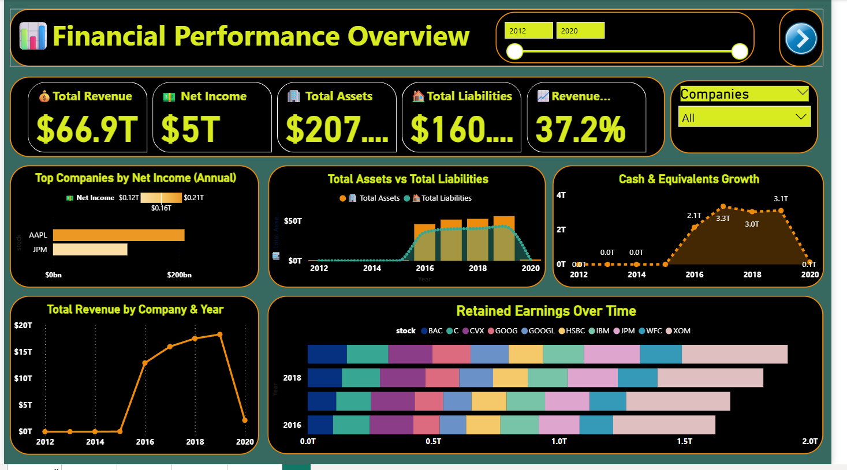

Slide 13
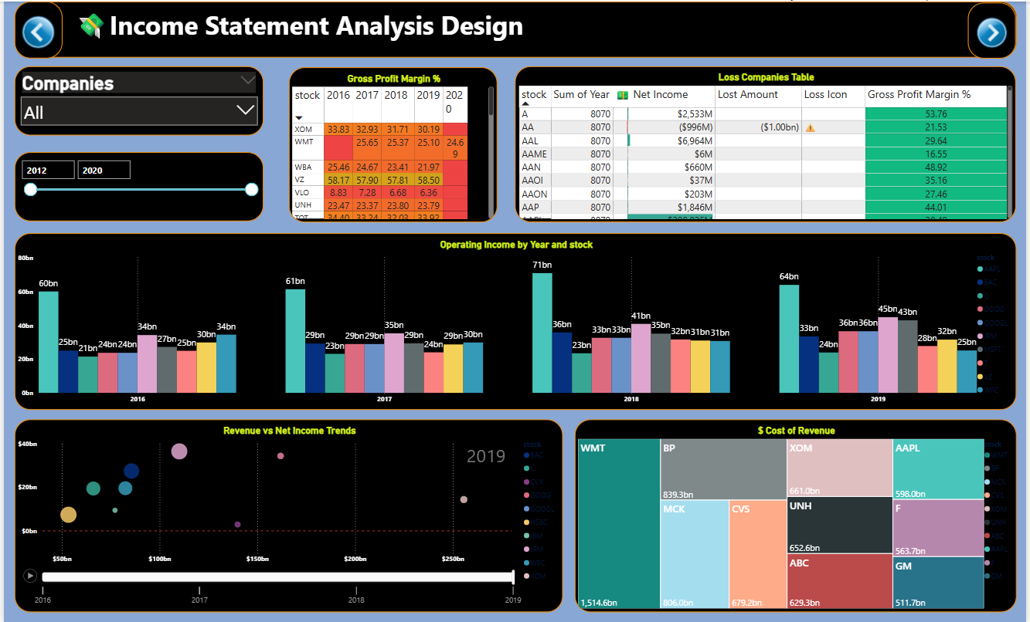

Slide 14
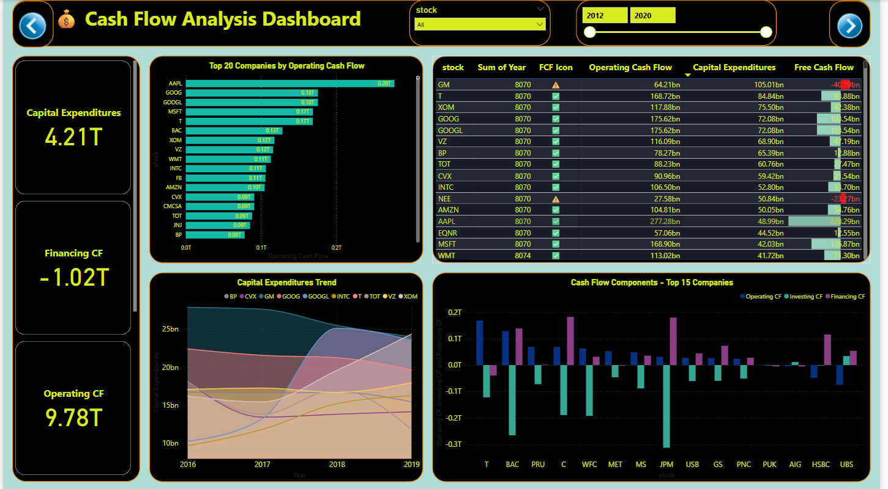

Slide 15
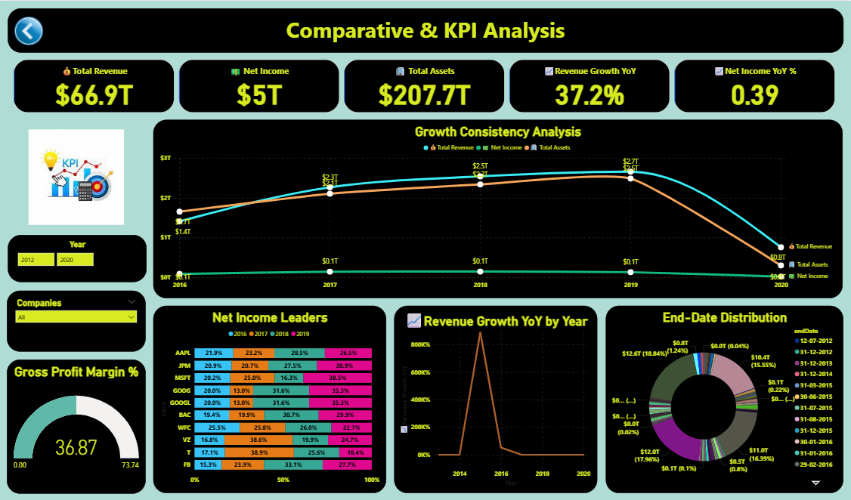

Slide 16
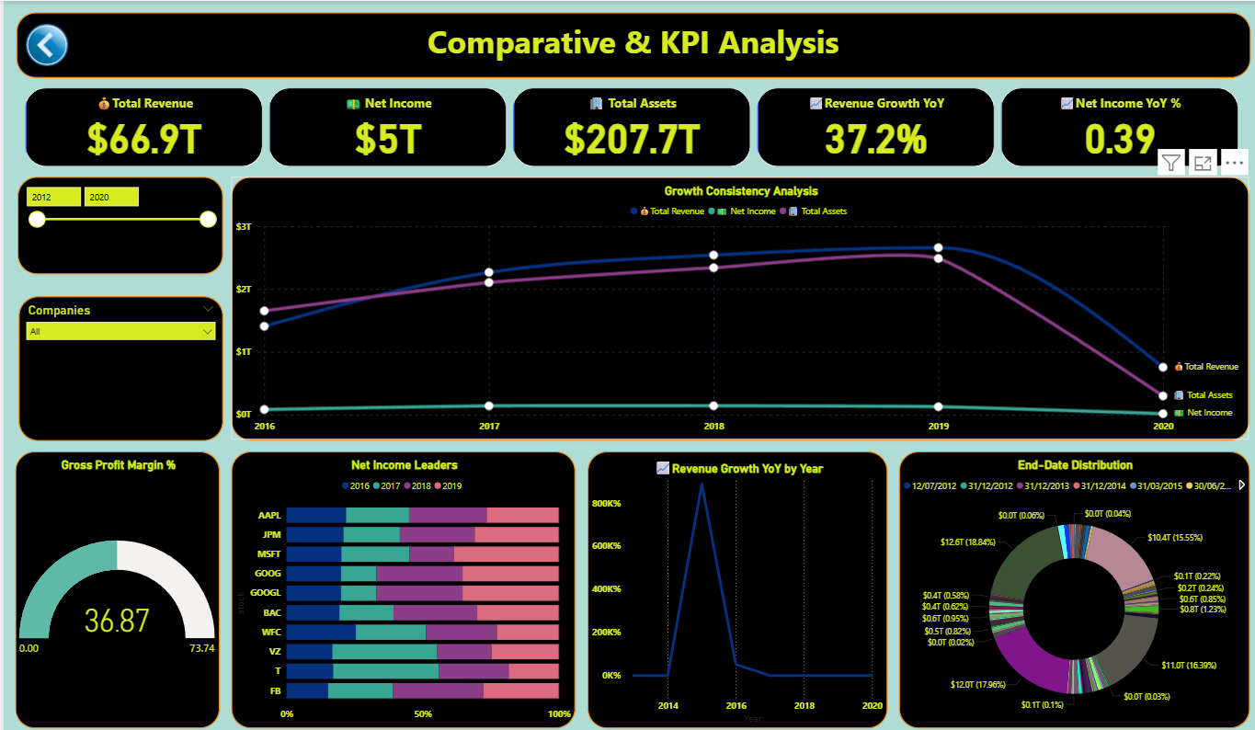

Slide 17
Applications & Recommendations
Applications
  Helps management evaluate company performance across Revenue, Profitability, Assets, and Cash Flow
  for better strategic planning.
  Enables comparison between companies to identify industry leaders and underperformers using KPIs like
  Net Income, Free Cash Flow, and Debt Ratios.
  Assists investors and analysts in tracking financial consistency, growth potential, and risk levels before
  making portfolio decisions.
Recommendations
  Focus on improving profit margins and cash flow efficiency.
  Reduce debt dependence to strengthen balance sheet stability.
  Maintain steady capital expenditure to support long-term asset growth.

Slide 18
Conclusion
  The Power BI dashboards provided a complete view of company performance across Income Statement, Balance Sheet, and Cash Flow data.
  Enabled accurate tracking of Revenue, Profitability, Assets, Liabilities, and Cash Flow over time for multiple companies.
  Helped identify high-performing companies, financial risks, and investment opportunities through interactive KPIs and visuals..
  Revealed consistent growth in top firms like AAPL, JPM, and MSFT, while some companies showed weaker free cash flow trends.
  Power BI’s dynamic visuals and DAX-driven measures simplified complex financial analysis into easy-to-understand dashboards..
  The project successfully transformed raw financial data into actionable business insights, enabling smarter financial decisions and strategic planning.

Slide 19
ANY
Queries?

Slide 20

THANK YOU

